Slide 1

Linux Basics ( course II )
I am
root!
Florentiu Ilie

Slide 2
Course Content
Course1: Startup and Shutdown +
Course2: Linux directory tree, SSH
Course3: File permissions, Environment variables +
Course4: Users, Groups, Jobs +
Course5: Processes, Logging, Archiving
Course6: Filesystems, Disk Partitioning
Course7: LVM
Course8: Backup, Useful commands
Course9: Networking
Course10: Basic Troubleshooting

Slide 3
Schedule
Initialization Test (20m)
Course 1-2(1h each)
Test 2 (20m)
Course 3-5
Test 3 (50m)
Course 6-7
Test 4 (30m)
Project ( 7days)
Project presentation (1h each student)
Course 8-10
Test 5 (20m)
Review of all courses 1-10 (1-2h)
Final Test 1 – theoretical (1h)
Final Test 2 – practical (1-2h)

Slide 4
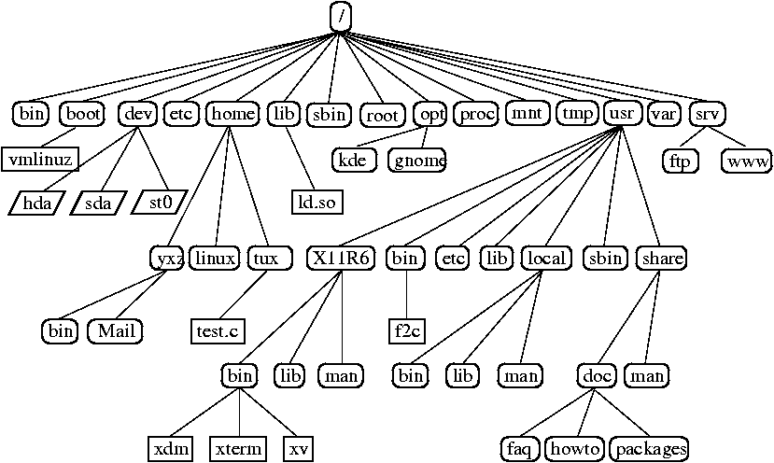
Linux directory tree
Everything is a file

Slide 5
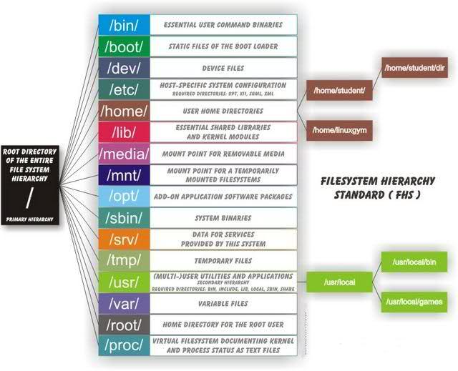
Linux directory tree

Slide 6
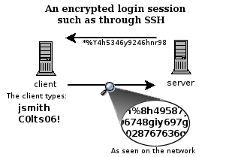
SSH
What is ssh ?
SSH, or Secure Shell, is a protocol used to securely log onto remote systems. Default Port: 22
Basic Syntax
The most basic form of the command is: ssh remote_host
How Does SSH Work ?

Slide 7
SSH
Installation:
Install the package via rpm/yum/zypper/apt-get: openssh
Configuration:
configuration file: /etc/ssh/sshd_config
SSH Keys: ( key generation command: ssh-keygen )
SSH keys allow authentication between two hosts without the need of a password. SSH key authentication uses two keys, a private key and a public key.
SSH Agent: ( command: ssh-agent )
ssh-agent is a program to hold private keys used for public key authentication (RSA, DSA, ECDSA)

Slide 8

Questions ?

